Slide 1

Chapter 1
Introduction
Instructor: Dr. Abhijit Sen
Copyright © The McGraw-Hill Companies, Inc. Permission required for reproduction or display.

Slide 2
Chapter 1
Objectives
  To define three security goals
  To define security attacks that threaten security goals
  To define security services and how they are related to the three security goals
  To define security mechanisms to provide security services
  To introduce two techniques, cryptography and steganography, to implement security mechanisms.

Slide 3
1-1 SECURITY GOALS
This section defines three security goals.
Topics discussed in this section:
1.1.1 Confidentiality
1.1.2 Integrity
1.1.3 Security

Slide 4
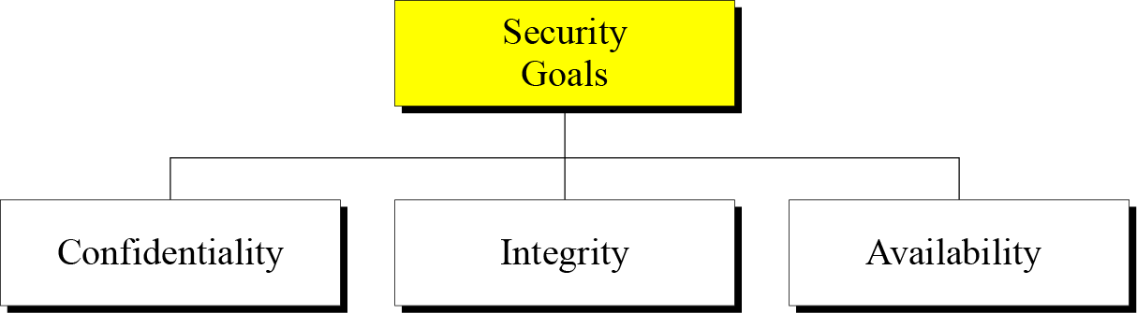
Figure 1.1 Taxonomy of security goals
Figure 1.1 Taxonomy of security goals

Slide 5
1.1.1 Confidentiality
Confidentiality is probably the most common aspect of information security. We need to protect our confidential information. An organization needs to guard against those malicious actions that endanger the confidentiality of its information.

Slide 6
1.1.2 Integrity
Information needs to be changed constantly. Integrity means that changes need to be done only by authorized entities and through authorized mechanisms.

Slide 7
1.1.3 Availability
The information created and stored by an organization needs to be available to authorized entities. Information needs to be constantly changed, which means it must be accessible to authorized entities.

Slide 8
1-2 ATTACKS
The three goals of security⎯confidentiality, integrity, and availability⎯can be threatened by security attacks.
Topics discussed in this section:
1.2.1 Attacks Threatening Confidentiality
1.2.2 Attacks Threatening Integrity
1.2.3 Attacks Threatening Availability
1.2.4 Passive versus Active Attacks

Slide 9
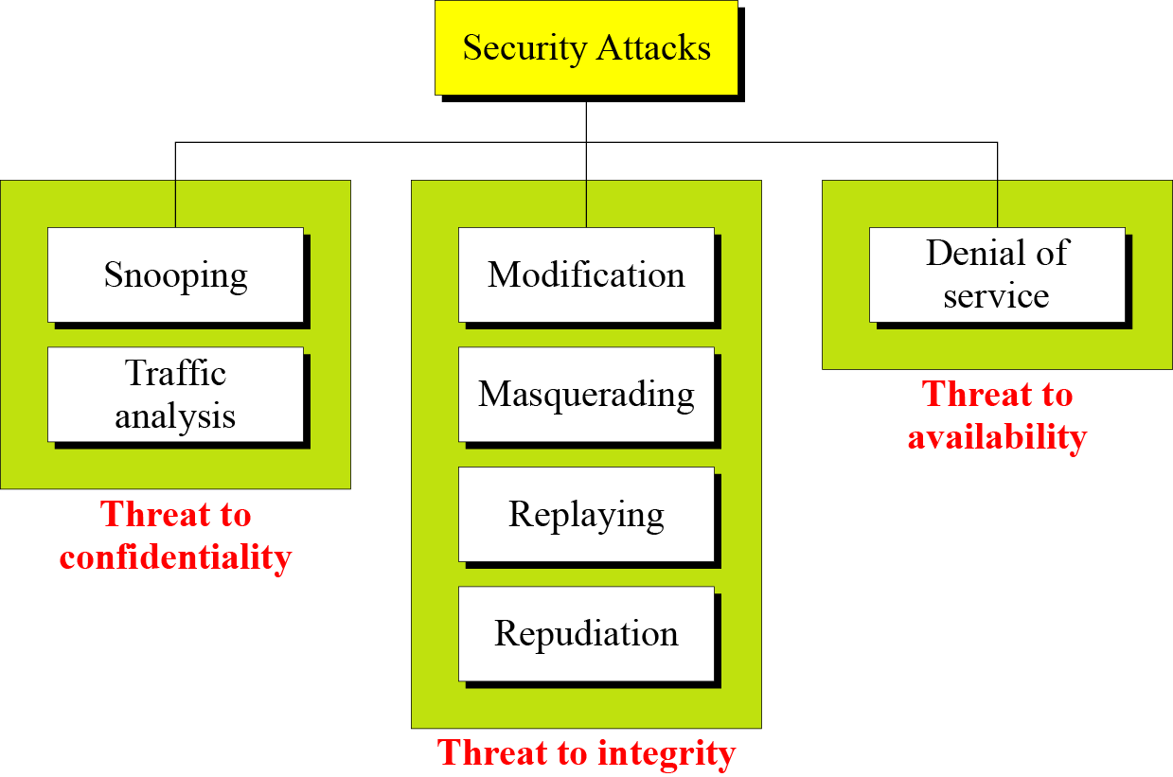
1.2 Continued
Figure 1.2 Taxonomy of attacks with relation to security goals

Slide 10
1.2.1 Attacks Threatening Confidentiality
Snooping refers to unauthorized access to or interception of data
Traffic analysis refers to obtaining some other type of information by monitoring online traffic.

Slide 11
1.2.2 Attacks Threatening Integrity
Modification means that the attacker intercepts the message and changes it.
Masquerading or spoofing happens when the attacker impersonates somebody else.

Slide 12
1.2.2 Attacks Threatening Integrity
Replaying means the attacker obtains a copy of a message sent by a user and later tries to replay it.
Repudiation means that sender of the message might later deny that she has sent the message; the receiver of the message might later deny that he has received the message.

Slide 13
1.2.3 Attacks Threatening Availability
Denial of service (DoS) is a very common attack. It may slow down or totally interrupt the service of a system.

Slide 14
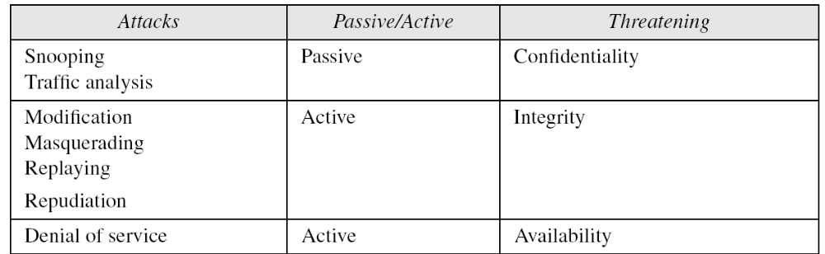
1.2.4 Passive Versus Active Attacks
Table 1.1 Categorization of passive and active attacks

Slide 15
1-3 SERVICES AND MECHANISMS
ITU-T provides some security services and some mechanisms to implement those services. Security services and mechanisms are closely related because a
mechanism or combination of mechanisms are used to provide a service..
Topics discussed in this section:
1.3.1 Security Services
1.3.2 Security Mechanism
1.3.3 Relation between Services and Mechanisms

Slide 16
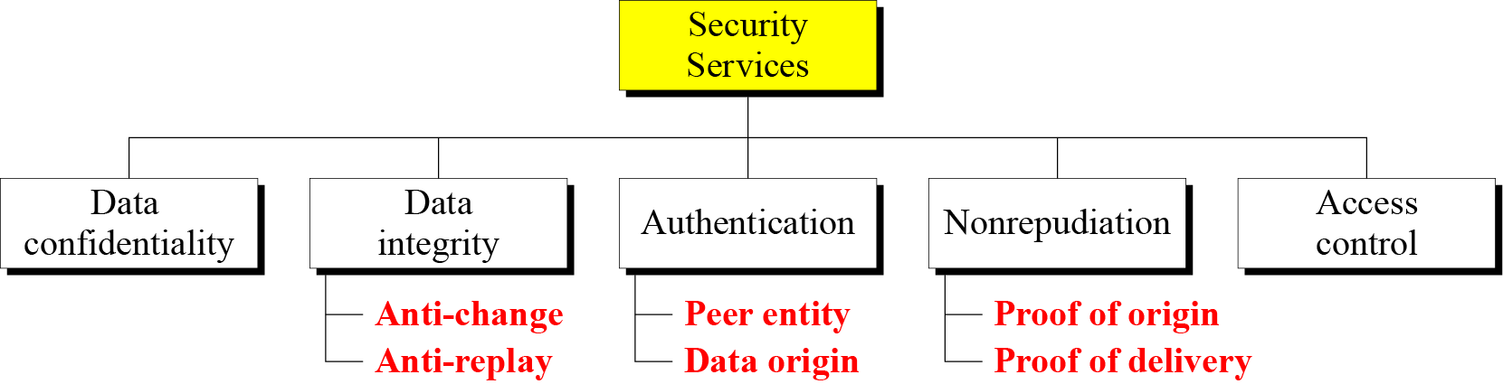
1.3.1 Security Services
Figure 1.3 Security services

Slide 17
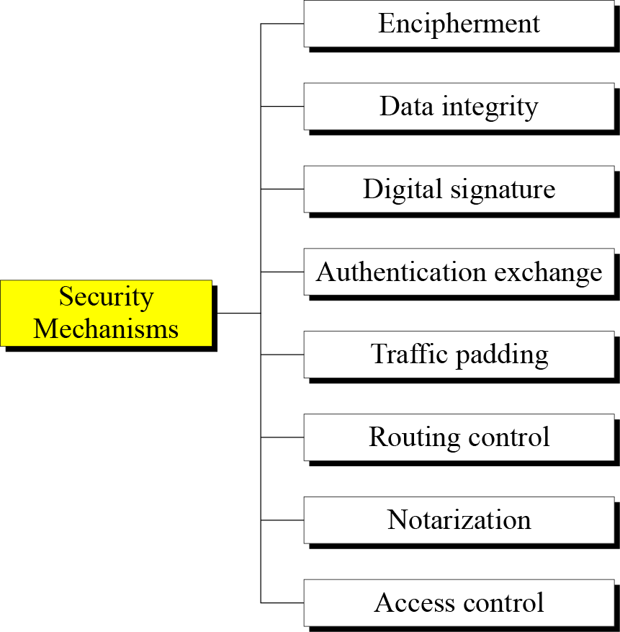
1.3.2 Security Mechanism
Figure 1.4 Security mechanisms

Slide 18
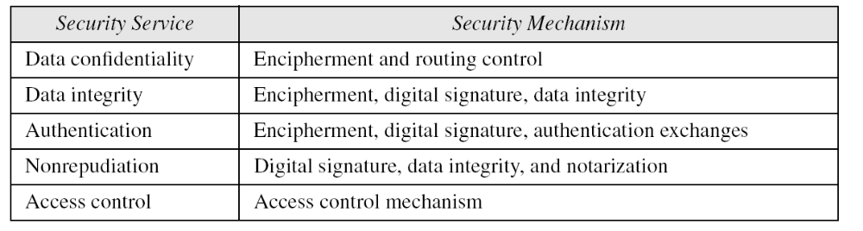
1.3.3 Relation between Services and
Mechanisms
Table 1.2 Relation between security services and mechanisms

Slide 19
1-4 TECHNIQUES
Mechanisms discussed in the previous sections are only theoretical recipes to implement security. The actual implementation of security goals needs some techniques. Two techniques are prevalent today: cryptography and steganography.
Topics discussed in this section:
1.4.1 Cryptography
1.4.2 Steganography

Slide 20
1.4.1 Cryptography
Cryptography, a word with Greek origins,
means “secret writing.”
However, we use the term to refer to
the science and art of transforming
messages to make them secure and
immune to attacks.

Slide 21
What is Cryptography?
Cryptography is the science of information
security.
It can also be defined as “the means and
methods for hiding information and
preventing its modification”.

Slide 22
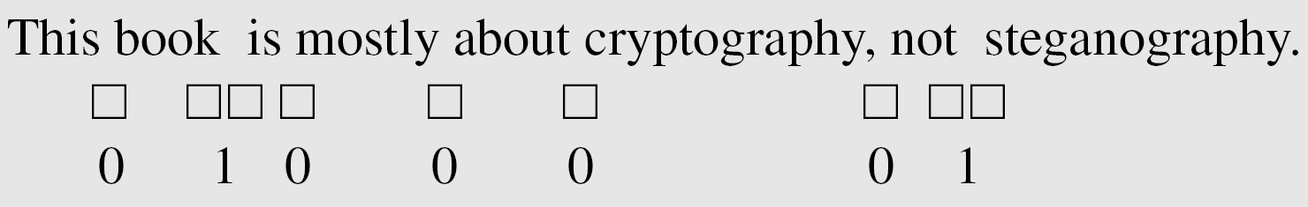
1.4.2 Steganography
The word steganography, with origin in Greek, means “covered writing,” in contrast with cryptography, which means “secret writing.”
Example: covering data with text

Slide 23
1-5 THE REST OF THE BOOK
The rest of this book is divided into four parts.
Part One: Symmetric-Key Enciphermen
Part Two: Asymmetric-Key Encipherment
Part Three: Integrity, Authentication, and Key Management
Part Four: Network Security

Slide 24
Basic terms
A cipher is a method for encrypting a message –
i.e., for transforming the message into one
that can't be easily read, method of concealing
the meaning of text using substitution and
transposition.
The original message is called the plaintext
or clear and the encrypted message is called
a cryptogram or ciphertext.

Slide 25
Basic terms
Encryption/Encipherment
  scrambling data into unintelligible to unauthorised parties
Decryption/Decipherment
  un-scrambling

Slide 26
Basic terms
Encryption: Scramble Message so that Interceptor Cannot Read it
  Plaintext (message) readable text before it’s transposed or (encrypted).
  Ciphertext (scrambled) for transmission
  Encryption and Decryption Method and Key

Slide 27
Basic terms
Encryption uses an encryption algorithm and a key to change some input (plaintext) to some output (ciphertext)
  ciphertext looks like random string of bits to observers who do not know the appropriate decryption algorithm and key

Slide 28
Basic terms
Decryption- taking encrypted text (ciphertext) and changing it back to it’s original readable text (plaintext).
Key- a variable applied to a block or string of unencrypted text (plaintext) to an encrypted text (ciphertext) or vise versa.

Slide 29
Basic terms
Encryption: A cipher takes the plaintext and applies a transformation function using a key. This produces the ciphertext.
This is then sent to the receiver.
Decryption: The receiver then applies another transformation to the ciphertext using a different key to unlock the plaintext.

Slide 30
Basic terms
Cryptology (to be very precise)
  cryptography --- designing
  cryptanalysis --- code breaking
    Cryptologist
    Cryptographer
    cryptanalyst

Slide 31
Encryption
IBM
HAL
IBM
Plaintext
Encryption
Ciphertext
Decryption
Plaintext
Method
Key
Transmitted
Method
Key

Slide 32
Encryption
Encryption Method and Key
  Method is algorithm: Subtract N letters
  Key is specific value: N=1 (I=>H, B=>A, etc.)
  Method cannot be kept secret
  Key must be kept secret
IBM
HAL
IBM
Plaintext
Encryption
Ciphertext
Decryption
Plaintext
Method
Key
Transmitted
Method
Key

Slide 33
What’s the secret?
Good ciphers rely on the key being unknown and secure even if the algorithm is known.
This makes it easy to use cryptography in every day life because it relies on a standard set of ciphers and can be used to ensure communication between all parties.

Slide 34
Secure Systems
Ciphers are only part of a complete security package
System
Hardware/Software
Protocol
Process for multi-round message exchange
OP: encipher, . . .
Actual Transformation
Cipher: DES, RSA, . . .
Cipher Algorithms

Slide 35
A Good Cipher
Enciphering and deciphering should be efficient for all keys - it should not take forever to get message.
Easy to use. The problem with hard to use cryptosystems is that mistakes tend to be made

Slide 36
A Good Cipher
The strength of the system should not lie in the secrecy of your algorithms. The strength of the system should only depend the secrecy of your key.

Slide 37
Cipher Classification
Ciphers
Public Key
Symmetric
Key
Unkeyed
PublicKey
Signature
ID
Random
OneWay
Hash
Random
Signature
MAC
Symmetric
Classical
Stream
Block
Transposition
Substitution

Slide 38



Cipher Environment
The typical communication environment for discussing ciphers is
plaintext
eavesdrop
Alice
Bob
Eve

Slide 39
Cipher System
If Alice and Bob use a cipher system, this environment becomes:
plaintext
ciphertext
cipher
plaintext
cipher
key
key
Alice
eavesdrop
Bob
Eve

Slide 40
Reference
General Cryptographic Knowledge: http://www.cs.plu.edu/courses/CompSec/arts/gck.pdf

